Slide 1
Response: bridging the link between intrusion detection alerts and security policies
Sharada Valiveti

Slide 2
Contents
Introduction
Problem Statement
Security Policy Formalism
Applying Or-BAC for threat response
The Threat Response System
From alerts to new policies
Case Study: e-mail Server
Issues with the approach
Conclusions

Slide 3
Introduction
Drawbacks of IPS
Response is applied on a single point of information system
Application is repeated every time an alert is raised
Issues:
Lighten hardware budget leading to conflicting choices and compromises in Security
Performance and convenience
Ease and use of automation

Slide 4
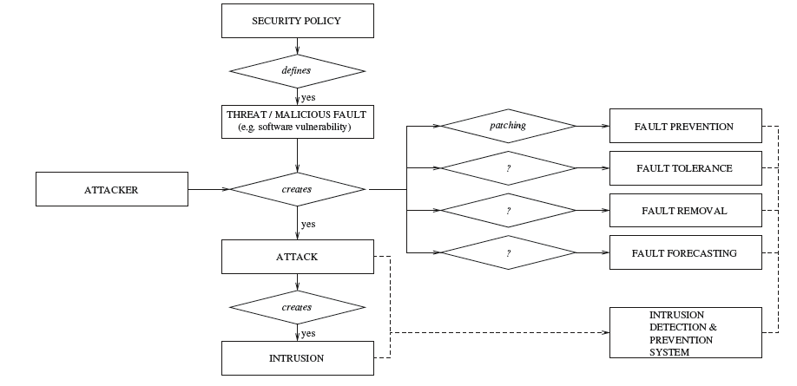
Problem Statement
Domain Terminology
Focus on actions of fault tolerance or removal

Slide 5
Problem Statement
Intrusion Prevention and Response
Network based Intrusion Prevention System
Host based Intrusion Prevention System
Comprehensive Approach to Response
Access control technologies are located at critical points of network
Link threat detection performed by intrusion detection/prevention systems and access control mechanisms, to provide an adaptive security policy capable of dynamically adjusting to threats

Slide 6
Security Policy Formalism
Choice of a Security Policy Formalism
Security administrator has to manually update policy by removing obsolete security rules or inserting new security rules
Objective is to design a method to help administrator in these tasks of updating policy
Model to specify security policies that dynamically change when some intrusion is detected
Security rules refer to permissions and prohibitions
Model must provide means to manage conflicts between permissions and prohibitions
Minimal security requirements
Model should specify high level conflict management strategies to find best compromise between conflicting rules

Slide 7
Security Policy Formalism
The Or-BAC Formalism
Concrete Security Components are viewed as Organization
Suggests reasoning with roles that subjects, actions or objects play in organization
Role of subject is called role
Role of action is called activity
Role of object is called view
Organization defines security rules which specify that some roles are permitted or prohibited to carry out some activities on some views
Security rules do not apply statically but their activation may depend on contextual conditions

Slide 8
Security Policy Formalism
The Or-BAC Formalism
Security rules are modeled using 6-places predicate:
Security_rule(type, org, role, activity, view, context) where type belongs to {permission, prohibition}
Permissions and prohibitions are both inherited through these hierarchies
Priority is associated with each security rule to handle conflicts
Compatible with hierarchies defined on entities
If security rule is inherited by a given entity, this rule will have lower priority than another security rule explicitly assigned to this entity

Slide 9
Security Policy Formalism
Conflict management strategy will solve every conflict at concrete level
Modeled using 3 places predicates
empower (org,subject,role)
In org, subject is empowered in role
consider (org,action,activity)
In org, action is considered an implementation of activity
use(org,object,view)
In org, object is used in view

Slide 10
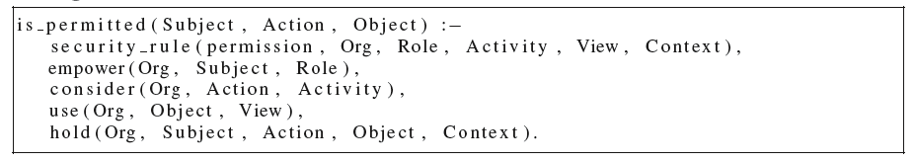
Security Policy Formalism
Or-BAC Contexts
Represented by logical rules that derive the following predicate:
Hold(org, subject, action, object, context): in org, subject performs action on object in context context

Slide 11
Security Policy Formalism
Presentation of a use case
Users have access to their mail located on remote exchange servers
3 different mail clients
Outlook (Access Exchange server through native Microsoft protocols)
Thunderbird (Access POP and IMAP extensions of same exchange servers)
Firefox (Access OWA extension of same exchange server)
All 4 modes are active and allow parallel access to same information
Consistency preserved by backend exchange server

Slide 12
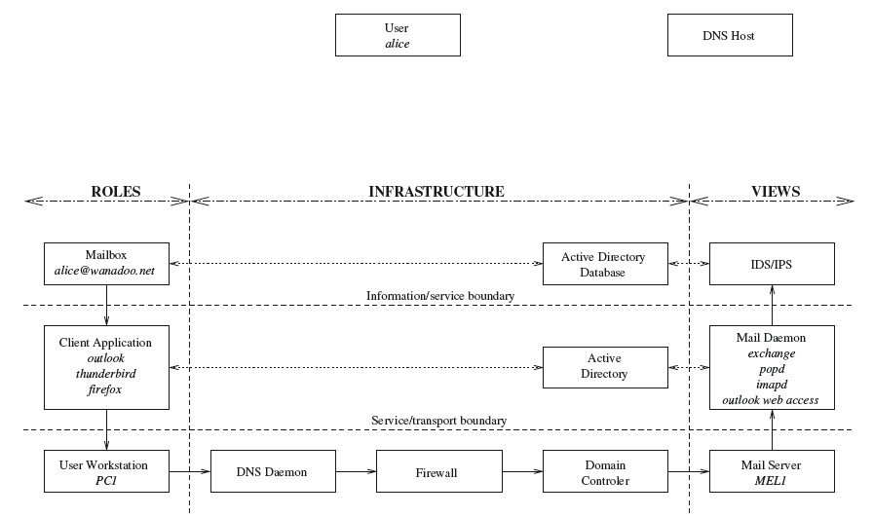
Security Policy Formalism
Presentation of a use case
Use case illustration / Horizontal/ Vertical Segmentation

Slide 13
Security Policy Formalism
Presentation of a use case
Impact on policy enforcement
Vertical segmentation models infrastructure components and their interactions reliably
Routing
Handshaking
Sessions
Configuration information

Slide 14
Security Policy Formalism
Modeling of the Use Case
Tree representation where properties propagate
Abstract entities are represented as ovals and concrete entities are represented as square boxes

Slide 15
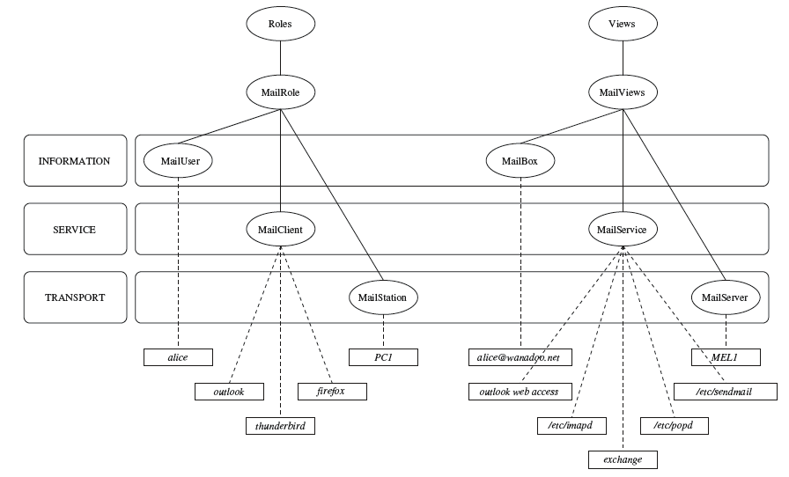
Security Policy Formalism
Modeling of the Use Case

Slide 16
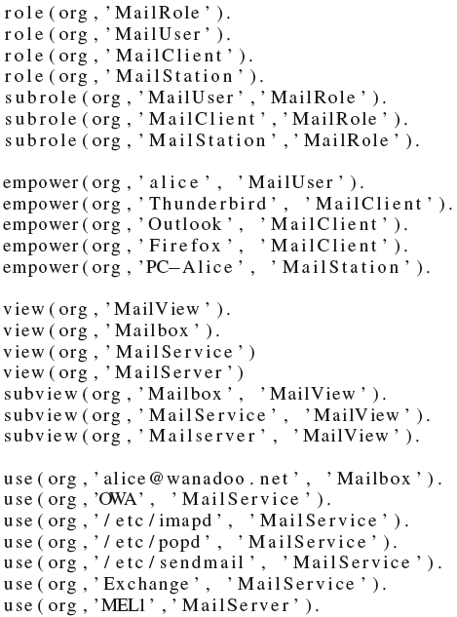

Slide 17
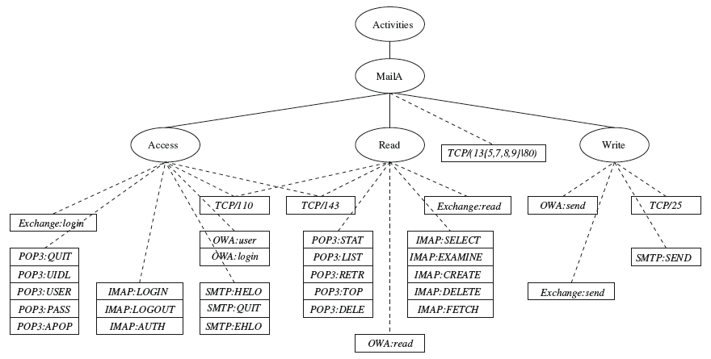
Security Policy Formalism
Activities

Slide 18
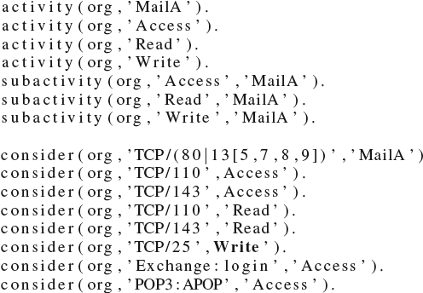
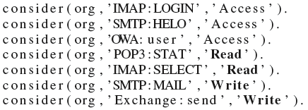
Security Policy Formalism

Slide 19
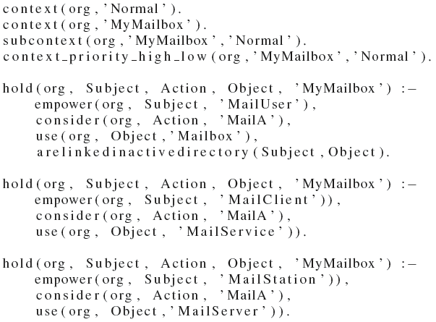
Security Policy Formalism
Contexts

Slide 20
Security Policy Formalism
Security Rules

Slide 21
Applying Or-BAC for threat response
Or-BAC contexts provide a natural way to include threat response into Or-BAC policy rules
Create specific rules that apply during an attack
Manage contexts according to threat information
Threat contexts refer to contexts used to characterize threats and provide threat response
based on using contexts to model how to dynamically update the security policy when a threat is detected
Core of this proposal is to manage contexts according to threat information

Slide 22
Applying Or-BAC for threat response
Syn-Flooding attack
a classification reference equal to CVE-1999-0116
the target is attacked through a service whose name is http (or port is tcp/80)
the target corresponds to a network node whose name is ws
Prolog Translation follows:

Slide 23
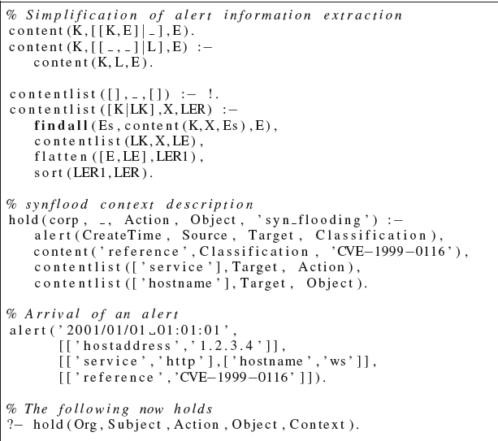

Slide 24
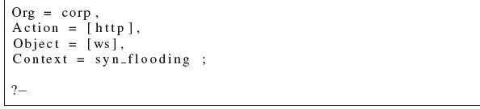
new fact(s) hold(org, s,a,o,c) is (are) derived for some threat context c
hold(org, _ http, ws, syn flooding): means that host ws is now in the threat context syn flooding through http
security rule (prohib, org, internet , tcp-service, web server, syn flooding): means that, in the threat context syn flooding, internet is prohibited to perform tcp service activity on the web server

Slide 25
Applying Or-BAC for threat response
Pop Reconnaissance Attack
a classification reference equal to CVE-2005-1133
the target is attacked through a service whose port is tcp/110 (or name is pop3)
a source that corresponds to a mail user whose name is Charlie
the target corresponds to a network node whose name is ms, then the pop attack context is active for Charlie subject making tcp/110 action on ms object

Slide 26
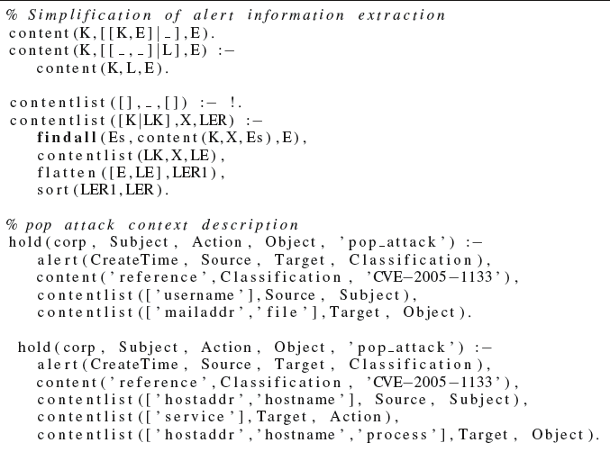

Slide 27
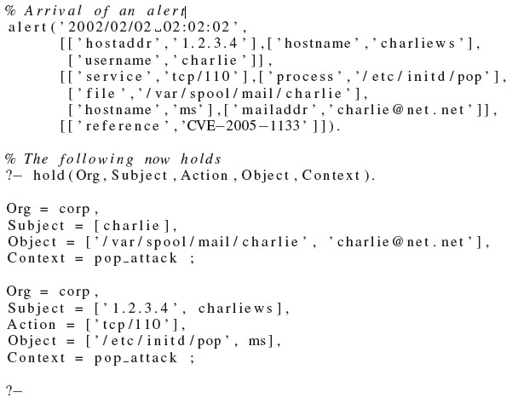

Slide 28
Applying Or-BAC for threat response
hold(org, charlie, _, [′charlie@net.net′, ′/var/spool/mail/charlie′], pop attack):
Mailbox charlie@net.net (and its sibling representation ’/var/spool/-mail/charlie’ mail spool file) is now in the threat context pop attack, the attacker being user Charlie
hold(org,[’1.2.3.4’, Charliews], [’tcp/110’], [’/etc/initd/pop’, ms], pop attack)
processes /etc/initd/pop and server ms are now in the threat context pop attack, the attack coming from workstation charliews with IP address 1.2.3.4
security rule(prohib,org,mail user, read pop,mail server, pop attack)
In the threat context pop attack, a mail user is prohibited to perform read pop activity on the mail server

Slide 29
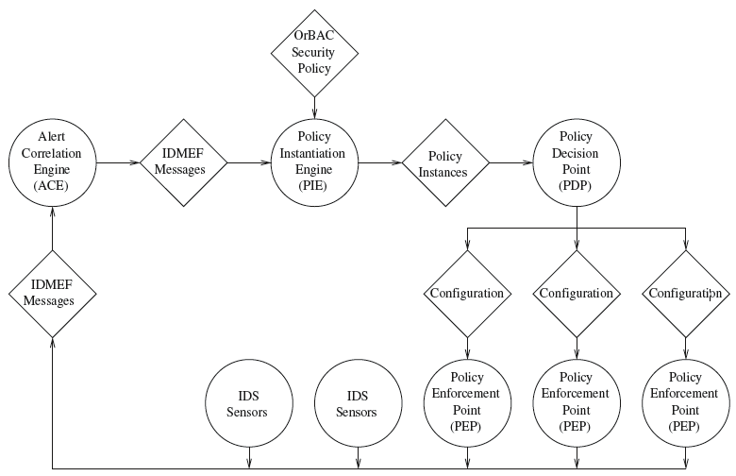
Threat Response System Architecture

Slide 30
Threat Response System Architecture
Alert Correlation Engine (ACE)
ACE as an entity receiving as input every possible event produced by sensors and giving as output high-level IDMEF-compliant alerts (meta-alerts)
Policy Instantiation Engine (PIE)
activate contexts (through Or-BAC hold facts)
trigger re-evaluation of the security policy (through activation of abstract Or-BAC rules)
Policy Decision Point
A PDP is in charge of local policy decisions
Whenever it receives a new policy instance, that is an Or-BAC concrete rule (permission or prohibition), a PDP has to map this information onto concrete actions to be performed on PEPs to enforce the new policy
Policy Enforcement Point (PEP)
PEPs receive new policies (or policy elements), which have been translated by the PDP
Expressing a new policy may have implications on multiple PEPs (For e.g. servers and firewalls)

Slide 31
Threat Response System Architecture
The PIE is divided into two subparts allowing
to map alerts reported as IDMEF messages into Or-BAC hold facts characterizing threats and allowing adequate countermeasures
to derive new policy instances thanks to hold facts and to the abstract policy definition
Information workflow from alerts to new policy instances is as shown in next figure
Threat Characterization Engine (TCE)
TCE process is divided into three steps:
Syntactic Mapping
Enrichment (2 steps)
enrich subjects, actions and objects which are only partially instantiated
find similar actions to instantiated ones, but at different levels
Strategic Mapping
this process needs IDMEF information related to context triggering (for instance, Classification.Reference)

Slide 32
